Slide 1

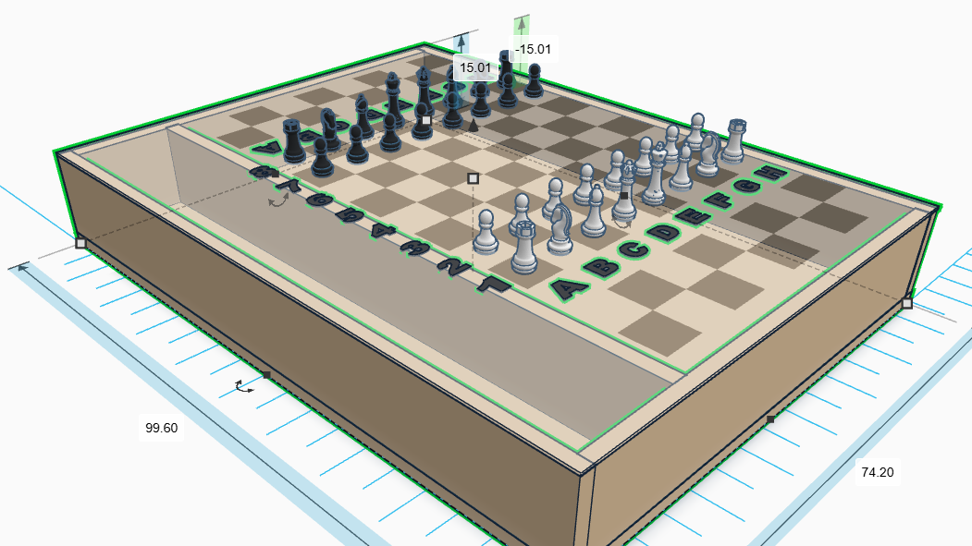





Chess Impress
Nathan MacPherson
Lewis Bates
Jack Tolleson
Allison Givens
Noah Beaty

Slide 2
Outline
Problem Formulation
Standards, Ethics, and Broader Impacts
Overview of Conceptual Design
Detailed Design
Implementation and Experimentation
Demonstration
Lessons Learned

Slide 3

Background
More automated chess boards are being made, allowing people to interact with over the board chess in new ways.
They are expensive and inaccessible to most people.
This project is tailored more towards the average chess player, giving them a new and exciting way to play.
Worked with the TN Tech Chess Club to get feedback from more experienced chess players.
Source: Chess.com, “The Rise of Smart Chess Boards,” 2023

Slide 4
Problem Formulation
Board shall reliably take in voice input of any kind.
Board shall be able to consistently and precisely move chess pieces autonomously.
Board shall be cheaper than existing commercial solutions (~$500).

Slide 5
Outline
Problem Formulation
Standards, Ethics, and Broader Impacts
Overview of Conceptual Design
Detailed Design
Implementation and Experimentation
Demonstration
Lessons Learned

Slide 6
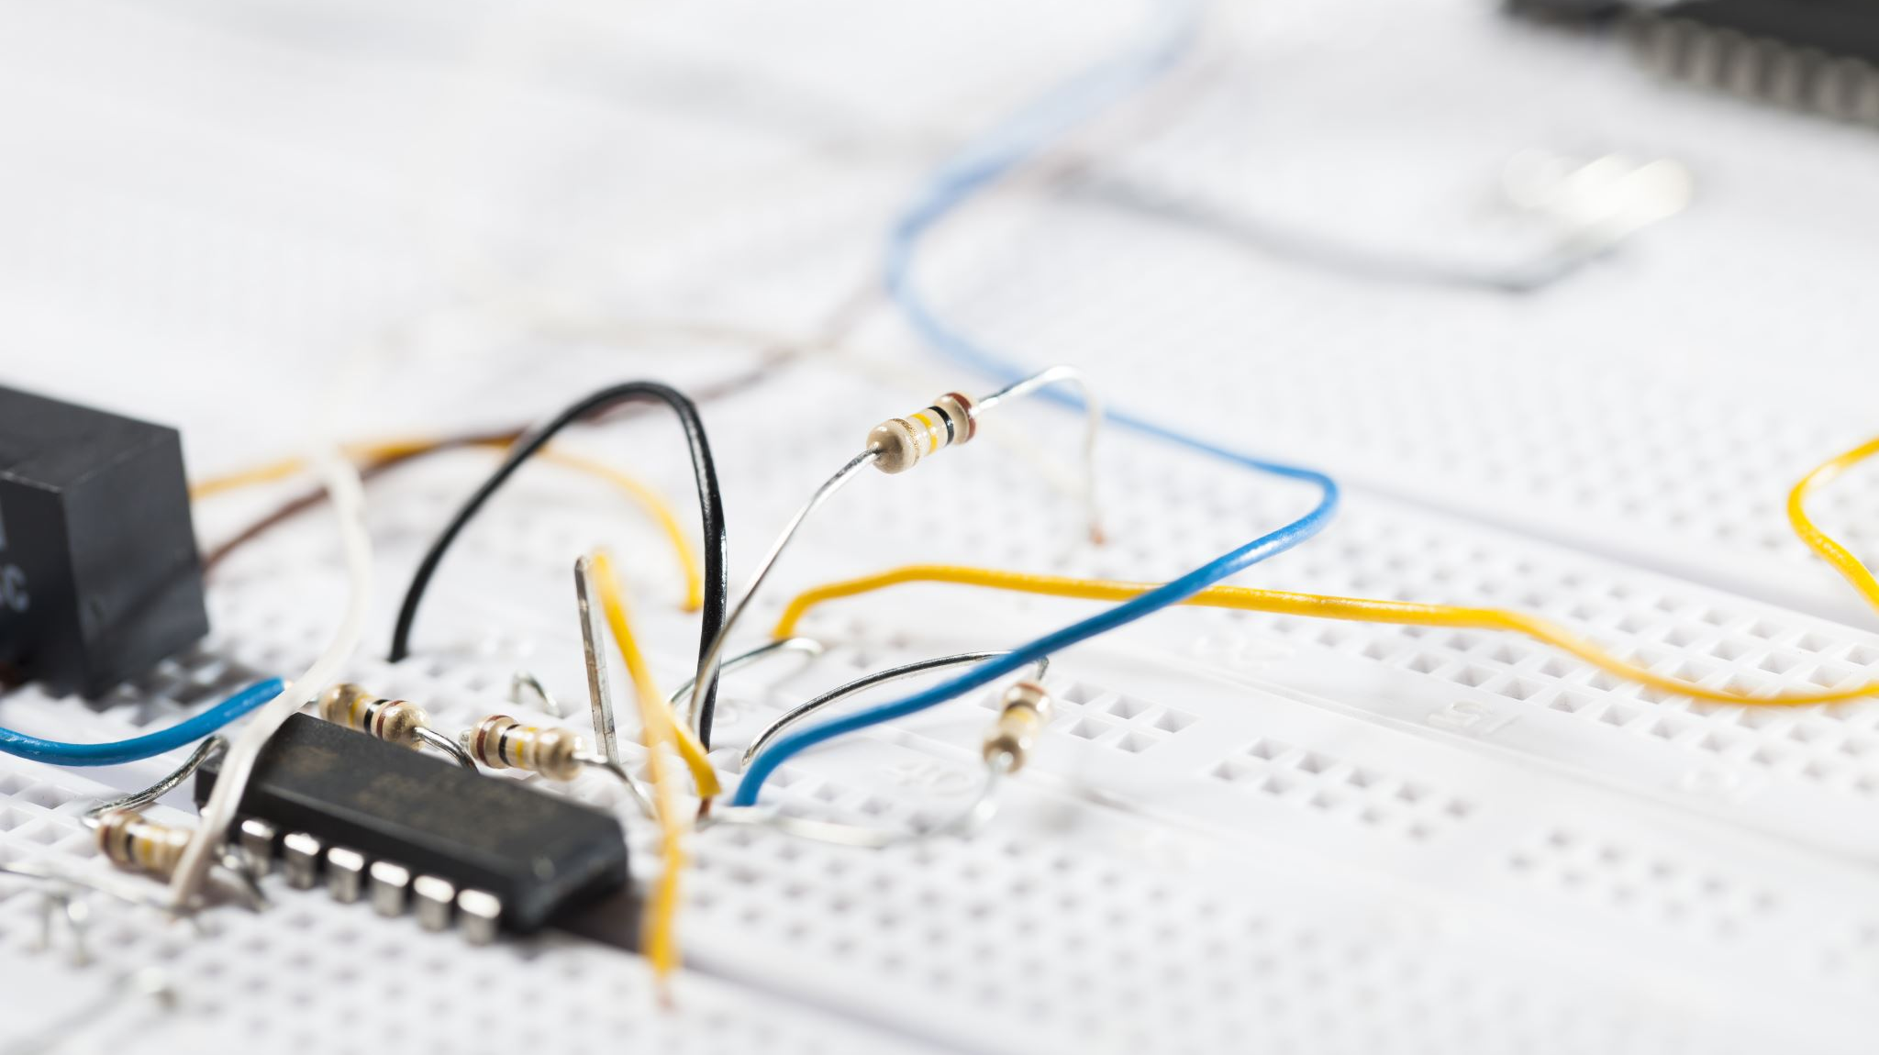
Standards, Ethics, and Broader Impacts
Standards Considered: Adhered to FCC Part 15 (EMI limits), UL 2054 (battery safety), NEC/NFPA 70 (low-voltage wiring), ANSI Z535.4 (safety labels), Section 508 (accessibility), IEEE 802.15.4 (wireless communication), ASTM F963 (toy safety), UL 60950-1 (IT equipment), WCAG 2.1 (voice interfaces), ISO/IEC 27001 (data security).
Ethical Considerations: Prioritized privacy via on-device voice processing; ensured accessibility equity with diverse voice datasets; credited open-source IP (e.g., Stockfish); promoted fair team collaboration per ACM Code of Ethics.
Broader Impacts: Enhances public health/safety via therapeutic, contactless play; promotes cultural/societal equity in chess access; minimizes environmental e-waste through modular design; supports economic innovation with open-source, low-cost replicability for hobbyists.

Slide 7
Outline
Problem Formulation
Standards, Ethics, and Broader Impacts
Overview of Conceptual Design
Detailed Design
Implementation and Experimentation
Demonstration
Lessons Learned

Slide 8
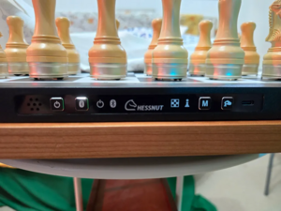
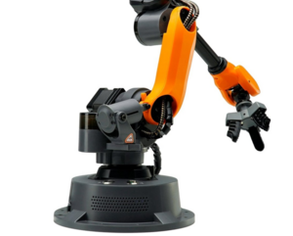
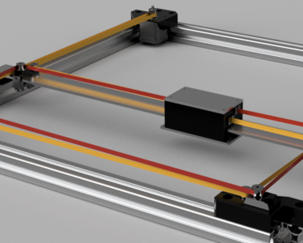
Conceptual Design
Finding the best solution to solve the specifications and constraints.
Main Problem: How can chess pieces move completely hands-free in a way that is low-cost, visually appealing, and safe?
Individual Micro-Robot System
Robotic Arm Manipulator System
CoreXY Motion System
Very Expensive
Bulky, Slow, Noisy
Hidden, Fast, Cheap

Slide 9
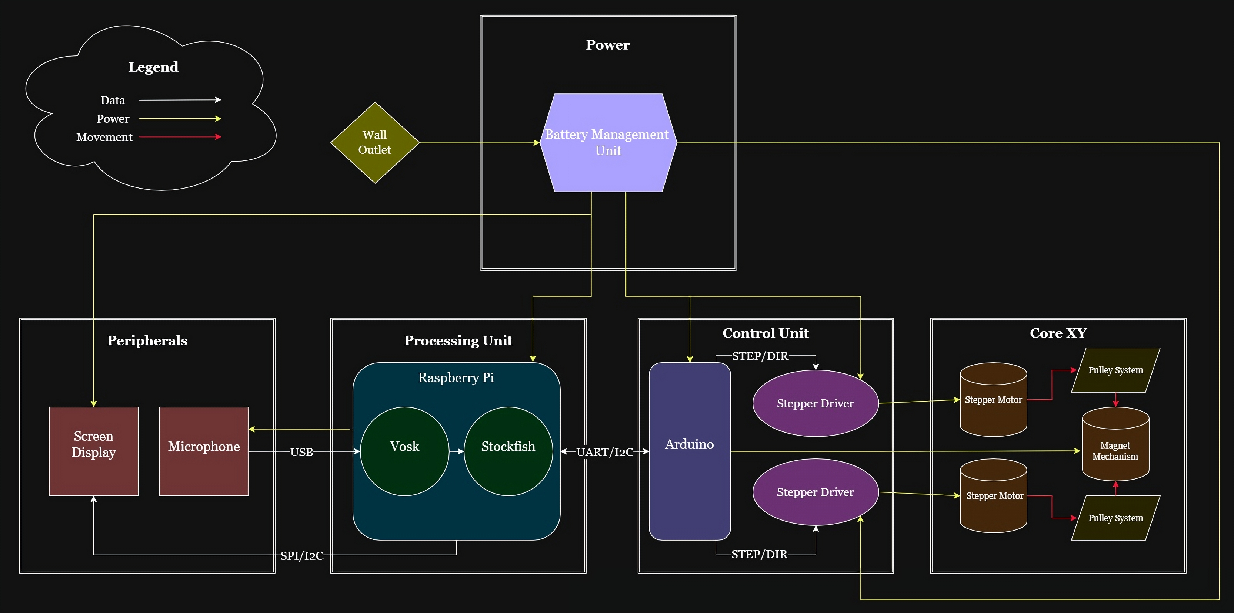
Chess Board Block Diagram
Five Different Subsystems
Processing Unit: Handles speech recognition, move validation, AI, and board state.
Control Unit: Directs and coordinates piece movement.
CoreXY Unit: Mechanically moves chess pieces and uses a magnet mechanism to hold a piece.
Power Unit: Powers all motors and electronics.
Peripheral Unit: Physical board, pieces, microphone, and display.
Notes:
Processing Unit: Handles all chess logic. Uses Vosk for speech recognition and Stockfish for AI. Receives audio from the microphone, provides feedback to the display, and sends validated moves to the Control Unit.
Control Unit: Executes piece movement. Translates move commands into motor instructions and drives the stepper motors to position the Core XY system accurately, reducing load on the Processing Unit.
Core XY Unit: A stepper-motor–driven motion system similar to a 3D printer. Moves a magnetic mechanism under the board using pulleys to pick up, slide, and place chess pieces.
Peripheral Unit: The board will need to be big enough that the pieces can slide in between the other pieces when moving. The pieces will have a metal washer so that the magnet can connect to them. The input from the microphone will go to the Processing unit and the messages for the display will come from the same place.
- Power Unit: Battery-powered to allow portable operation. Provides two power rails: 5V and 12V for motors and electronics.

Slide 10
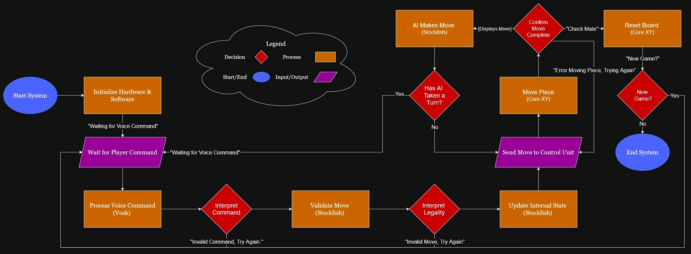
Chess Board Flow Diagram
To run a fully hands-free chess game, the system follows these steps:
The player gives a spoken command (e.g., “A5 to B6”).
The board validates the command for accuracy and legality.
The Processing Unit internalizes the move and sends it to the Control Unit, which moves the piece via the Core XY mechanism.
In single-player mode, the AI generates its move; otherwise, the system waits for the next command.
Play continues until checkmate, after which the board resets for a new game or shuts down if chosen.

Slide 11
Outline
Problem Formulation
Standards, Ethics, and Broader Impacts
Overview of Conceptual Design
Detailed Design
Implementation and Experimentation
Demonstration
Lessons Learned

Slide 12
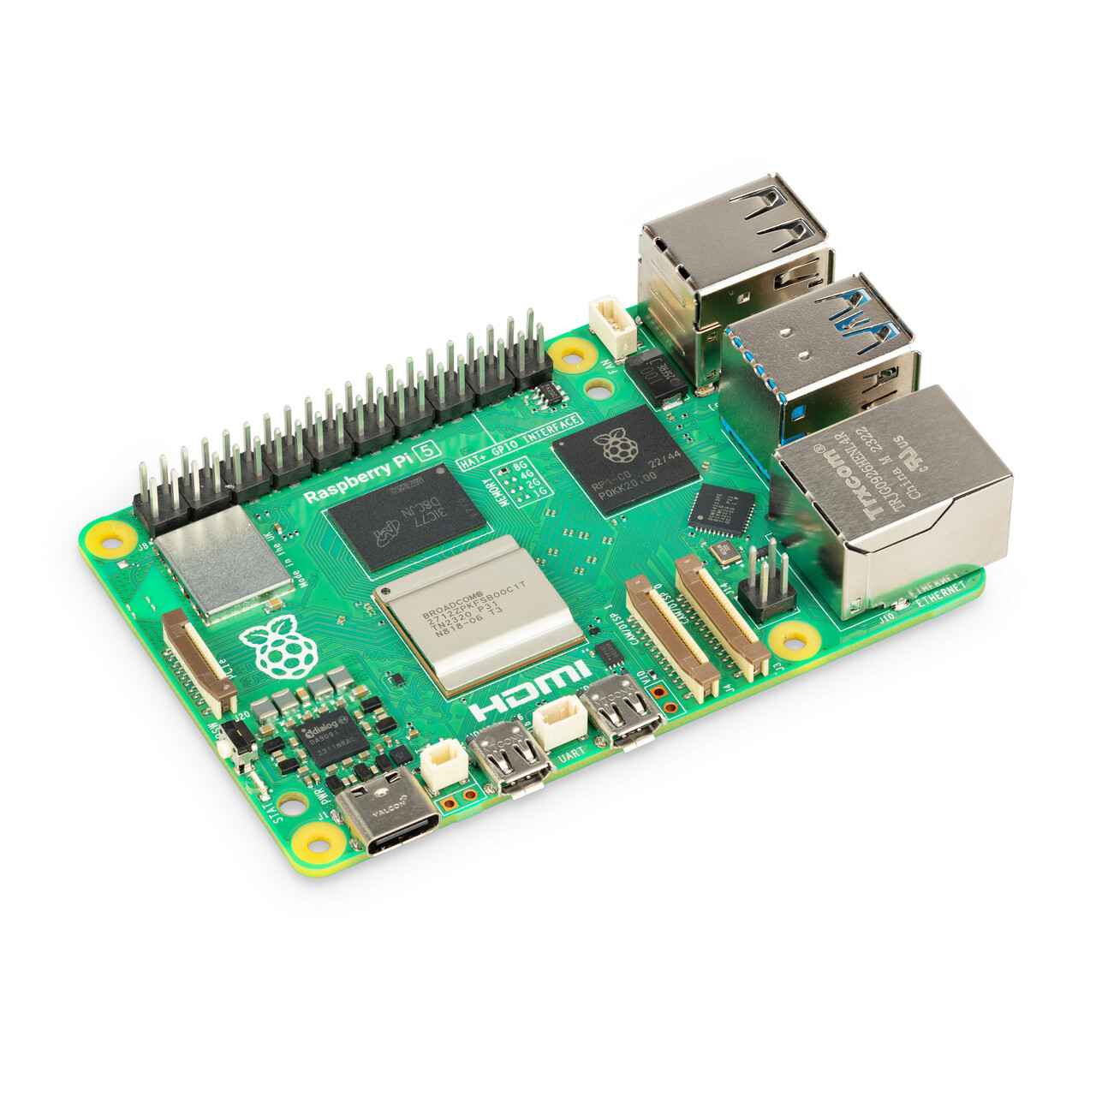
Processing Unit
Runs Vosk (speech‑to‑text), Python-Chess (move validation), Stockfish (AI)
Maintains full board state and interprets/validates voice commands
Interfaces with USB mic, LCD, and UART to Arduino Nano
Level‑shifts from 3.3V Raspberry Pi 5 to 5V Arduino Nano for safe UART communication
Has an attachable fan to reduce heating issues
Powers Nano and peripherals
Notes:
- Vosk is used for on-device speech recognition and should get 80% accuracy (supports chess-specific grammar and wake word)
PyChess validates moves, maintains board state, and enforces rules
Stockfish produces AI moves in “single-player mode”
- These three software and the high processing power of the Pi 5 should allow for a move to be validated and processed within 5 seconds
- All code written in Python (Vosk, PyChess, Stockfish bindings, and display libraries are all Python-compatible)
- Pi keeps full digital board representation and determines captures, promotions, and multi-piece sequences
- For captures or special cases (like castling), Pi sends multiple sequential movement instructions to the microcontroller
- Microphone communicates over USB and streams PCM audio into Vosk
- LCD display connects via SPI on the Pi’s GPIO header and uses framebuffers to send display data (ribbon cable relocates it for mounting convenience)
- LCD updates occur within 1 second to confirm commands, errors, or game status
- Pi to microcontroller requires bi-directional logic level shifter for safe UART communication (5V feedback from microcontroller would damage Pi)
Pi does not go over 5V which complies with the 40V max and has a fan to handle possible heat issues
----Original Slide----
Processing Unit:
Runs three major software components: Vosk (speech-to-text), PyChess (move validation), and Stockfish (AI)
Interfaces with microphone (USB), LCD display (SPI), and microcontroller (UART)
Maintains full board state and validates move commands
Uses logic-level conversion for safe UART signaling between 3.3V Pi and 5V Nano
Powers the microcontroller via 5V USB and supplies power to display and microphone
Has an attachable fan to reduce possible heating issues.

Slide 13
How specifications and constraints affected design
Gameplay required speech accuracy, move validation, and fast processing time
Privacy and accessibility requirements required recognition of a wide range of voices and clear listening indicators
Electrical safety standards called for a logic level shifter

Slide 14
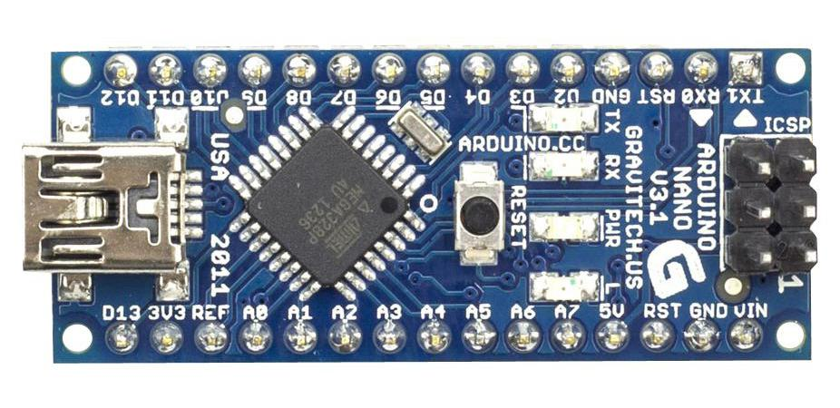
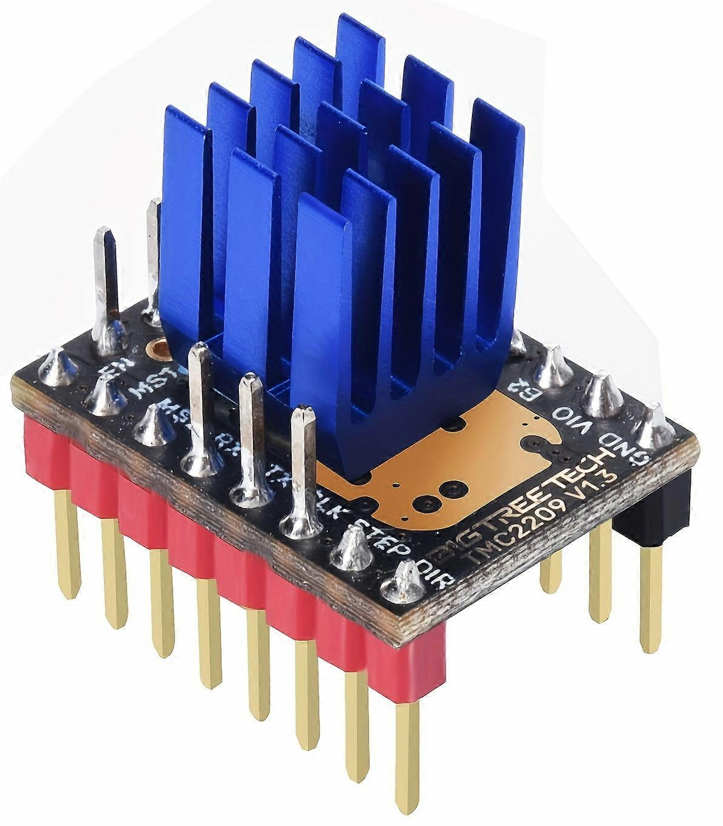
Control Unit
Arduino Nano receives source/destination squares from Pi over UART
Computes movement direction and type with edge‑prioritized movement pattern
Nano sends STEP/DIR signals to TMC2209 drivers
Controls electromagnet via MOSFET and protection components (flyback diode, gate resistor, and pulldown resistor)
Notes:
…..
Move directions include straight, diagonal, knight, and “castling”
specification of ±0.5 mm accuracy and 5 second movement
Heatsink added to each driver board to address temperature constraints
Each driver board sends move complete signal back to Nano for error handling
Flyback diode across the coil protects the system from voltage spikes when the magnet turns off (electrical safety constraints)
Gate pulldown resistor ensures the magnet stays off during resets (electrical safety constraints)
Gate resistor reduces oscillations in gate voltage switching and protects the Nano’s output pin (electrical safety constraints)
----Original Slide----
Control Unit:
Arduino Nano receives source square and destination square data over UART from Raspberry Pi 5
Nano makes decision on move direction and type, using an edge-prioritized movement pattern
Nano sends STEP/DIR move commands to both TMC2209 driver boards
Electromagnet circuit completed and controlled through MOSFET (flyback diode, gate resistor, and pulldown resistor include for safety)

Slide 15
How specifications and constraints affected design
High positional accuracy and low‑latency requirements drove the use of TMC2209 microstepping and a deterministic Nano‑based control loop
Electromagnet and stepper inductive loads required MOSFET switching with flyback protection and proper grounding
Thermal limits on the TMC2209 drivers required heatsinks and airflow planning to avoid overheating

Slide 16
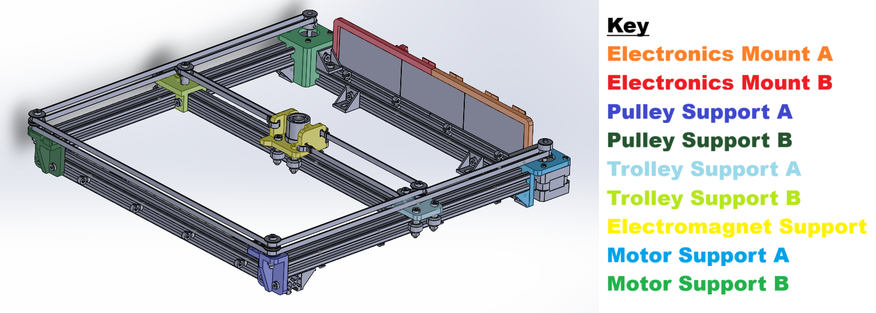
Corexy Unit
A two-belt motion system that moves magnetic actuator that powers on and “grabs” the magnets inside the pieces
Each motor controls diagonal motion
Same direction → X-axis
Opposite direction → Y-axis
The frame includes mounts for Nano, drivers, wiring
The Control Unit controls both the motors (by TMC2209 drivers) and the electromagnet (by MOSFET circuit) both of which receive power from the Power Supply Unit
Notes:
My subsystem is the CoreXY which is a two-belt motion system similar to a 3D printer that moves an electromagnet to move the pieces. Each motor moves the electromagnet along a diagonal when turned individually. When they turn the same way the electromagnet moves along the x-axis, and when they turn the opposite of each other the electromagnet moves along the y-axis. The frame includes mounts for the control unit and the wiring. The control unit controls the motors through the stepper motor drivers and the electromagnet through the MOSFET circuit. Both of which are powered by the power supply unit.

Slide 17
How specifications and constraints affected design
Required ±0.5 mm positioning accuracy drove belt‑tension tuning, pulley alignment, and a rigid frame geometry
Board dimensions directly set the CoreXY footprint, belt lengths, and travel range of the carriage
Safety and wiring standards guided enclosure layout, pinch‑point avoidance, and isolation of moving mechanical parts
Notes:
The positional constraints affected the mechanical setup of the CoreXY. The belt routing, belt tensioning, and frame stability were designed to minimize shaking in movement. The CoreXY was also constrained by the dimensions of the board. It had to be large enough to move the electromagnet to the center of every square in order to pick up the pieces, but small enough to fit in the board and allow space for the processing unit and power supply. With the motion of the electromagnet we also had to consider how to protect our wiring from any pinching. Most of the wires were routed away from the CoreXY, while the electromagnet leads were wrapped in a protective sleeve to keep them from being pinched on movements that brought the electromagnet close to the edges of the frame.

Slide 18

PERIPHERALs Unit
5" HDMI LCD and USB omnidirectional microphone are used for player interaction and feedback
Chessboard has 64 play squares and 32 storage squares each 2.25”
Pieces include neodymium magnets for magnetic movement
Board made of ¾ inch plywood on the sides, ½ inch plywood bottom, and 1/8th inch acrylic on top
Notes:
…..
…..
…..
----Original Slide----
Peripheral:
Uses 3.5” LCD display (SPI) and omnidirectional USB microphone for player interaction
Houses the chessboard with 64 main squares and 32 storage squares for captured pieces
Chess pieces contain embedded steel washers for magnetic manipulation by CoreXY
Interfaces with Processing Unit (Raspberry Pi 5) for voice input and visual feedback

Slide 19
How specifications and constraints affected design
USB‑audio requirements shaped microphone selection, placement, and cable routing
Display‑legibility and timing constraints required a high‑contrast LCD with simplified update patterns
Thermal and environmental limits shaped enclosure openings, venting, and safe surface‑temperature design

Slide 20

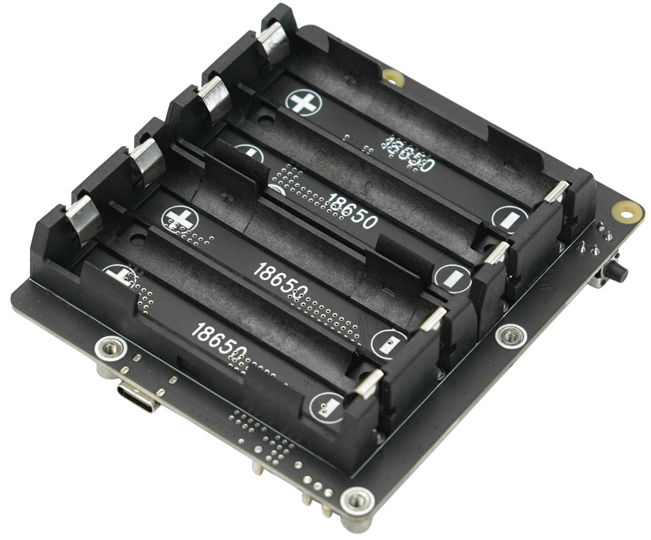
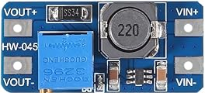
Power Supply Unit
UPS HAT and 4×18650 cells supply stable 5V, pass-through charging, and UPS functionality
MT3608 boosts 5V to 12V for stepper motors/drivers
Power is split into fused branches: one 5V line for Pi, Control Unit, and peripherals with the level shifter connected to the Pi’s 3.3V UART and a 12V line supplying the TMC2209 motor drivers
Supports sleep mode and seamless UPS switchover
Notes:
…..
…..
…..
----Original Slide----
Power Unit:
DFRobot UPS HAT + 4×18650 battery pack provides 5V logic rail, pass-through charging, and UPS functionality
MT3608 step-up converts 5V to 12V, sent to power stepper motors (separate 12V rail)
Dedicated fused branches: 5V to Pi/Control Unit/peripherals, 5V to buck (3.3V LV) for level shifter, and 12V to CoreXY motors
Sleep mode & PU-triggered inactivity for energy savings; UPS supports seamless switchover (<20 ms)
Design meets runtime and load goals (>2 hours at average draw), while keeping the power system compact and serviceable

Slide 21
How specifications and constraints affected design
Separate fused rails (5V logic, 12V motors) were required to prevent noise coupling and protect sensitive electronics
Runtime, load current, and voltage‑stability requirements drove the choice of UPS HAT, battery capacity, and regulated 5V distribution
Electrical safety and wiring standards shaped grounding, insulation, conductor sizing, and overcurrent protection

Slide 22
Outline
Problem Formulation
Standards, Ethics, and Broader Impacts
Overview of Conceptual Design
Detailed Design
Implementation and Experimentation
Demonstration
Lessons Learned

Slide 23
Implementation Peripherals unit
Started by cutting wood and gluing base together, then cutting acrylic top to fit board.
After original acrylic top broke when drilling, decided to laser cut/engrave new sheet with cutout for LCD screen.
CoreXY took more space than expected to reach full play area, had to scale down play area size from 2.5 to 2.25 inch/square, then cut 0.5 inch indent into side of base to allow full range and leave space for the processing and power units.
Pieces were 3d printed. 1 inch diameter, with differing heights for each piece, and added 5/8 inch hole in each base for magnets.
Made cutouts for intake fans, exhaust vents, and USB coupler.
Designed mount for PSU/PU, then superglued fans and mount in place.

Slide 24
Implementation corexy unit
Many of the 3D printed parts required re-designing and reprinting to work with the tolerances of our actual physical materials
The frame had to be rebuilt multiple times, including a full re‑dimensioning after the board top changed size
Cutting the extrusions too short forced a redesign, stretching the frame and reprinting parts to fit the undersized rails
Initial squareness issues were solved by adding additional corner brackets to stiffen the frame
Belt tensioning was trial‑and‑error; occasional skipping was fixed by re-tensioning and realigning the belts
The electromagnet mount could not be configured in a way that will reliably pick up and drop all pieces due to the nature of the acrylic
Notes:
When building the CoreXY, I had to redesign and reprint many of my 3D printed parts to work with the materials that I had actually purchased. The CoreXY had to be rebuilt multiple times including re-dimensioning when the board dimensions changed. When I was re-dimensioning the CoreXY, I accidentally cut the aluminum extrusions too short; which required me to stretch the CoreXY and redesign some of my supports to accommodate the stretching. Also initial issues with the squareness of the CoreXY were solved by adding more corner brackets, and belt tensioning was trial and error; it took some practice to determine proper tension to avoid backlashing. Also due to the warping nature of the acrylic, I was unable to find a mount height that would work in all positions on the board. It would either be too high in the middle and not let go of the pieces properly, or too low on the edges and not grab on to them.

Slide 25
Implementation Power supply unit
DFRobot UPS HAT was mounted directly on the Raspberry Pi 5 GPIO header, integrating the 4×18650 battery pack for stable 5 V output, pass-through charging, and automatic UPS switchover
Battery cells were voltage-matched prior to installation to ensure balanced discharge and reliable runtime
Two MT3608 boost converters were wired in parallel to generate the dedicated 12 V rail for the TMC2209 drivers, stepper motors, and electromagnet
Power distribution was split into fused branches (5 V logic rail for Pi/Control Unit/peripherals and 12 V motor rail) with inline fuses and a shared DC ground reference
Peak-load testing identified minor 5 V ripple excursions under simultaneous Pi + motor + electromagnet draw; additional bulk capacitance was planned for future revisions
Overall subsystem performed reliably, delivering seamless 0 ms UPS transitions, >2-hour battery runtime under full gameplay, and stable voltage regulation across all operating states

Slide 26
Software
Multithreaded architecture: three threads handle audio capture, Vosk speech recognition, and the main game loop independently so voice input never blocks physical board execution
Voice pipeline: Vosk runs on the device with a limited grammar of chess words, this stops false triggers and protects audio privacy without any internet
Move resolution: allows for both coordinate input (e2e4) and standard algebraic notation (knight f3, e takes d5), this is checked for legality before any physical command is sent
Physical board synchronization: a binary UART protocol sends 2-byte packets to the Arduino, with ACK confirmation per packet ensuring the digital and physical board states stay in sync
Automated reset: a greedy Manhattan distance algorithm calculates the minimum movement to return all pieces to starting positions after each game, accounting for captured pieces in the capture area of each color
Arduino firmware: decodes incoming binary packets, drives the coreXY stepper motors and electromagnet to physically execute each move, and returns ACK or NACK to confirm success
python-chess development team. (2024). python-chess: A chess library for Python (Version 1.10.0) [Software]. GitHub. https://github.com/niklasf/python-chess
Alpha Cephei. (2024). Vosk Offline Speech Recognition API (Version 0.3.45) [Software]. https://alphacephei.com/vosk/
Romstad, M., Costalba, M., Kiiski, J., & contributors. (2024). Stockfish: Open source chess engine (Version 16) [Software]. https://stockfishchess.org

Slide 27
ExperimentatioN
Passed (16/19):
Electrical/control tests all pass (fast EM switching, low latency, safe flyback, accurate recognition & validation)
Safety: 23/24 checklist items (zero Critical failures)
Power: UPS switchover, recovery, runtime ≥ 2h, low‑noise 5V rail, power use within 10% of budget
Portability: all 5 operators carried 36ft (without damage)
Failed (3/19):
Move completion time: initial constraint too strict (real avg 12.8s, vs 5s target)
Thermal safety: Pi5 slightly exceeded surface‑temp limit (107°F vs 104°F); not accessible to user, so no real hazard
Board weight: 33.2lb (spec 30lb), though still practically portable
Untestable (mechanical and magnetic issues prevented evaluation):
Collision‑free movement rate
Positional accuracy

Slide 28
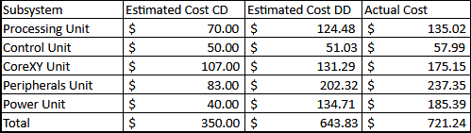

Budget overview
Scan for full Bill of Materials:
Underestimated costs in conceptual design (CD)
Differences between detailed design (DD) and actual cost:
Price changes over time
Extra/Replacement parts being ordered

Slide 29
Outline
Problem Formulation
Standards, Ethics, and Broader Impacts
Overview of Conceptual Design
Detailed Design
Implementation and Experimentation
Demonstration
Lessons Learned

Slide 30
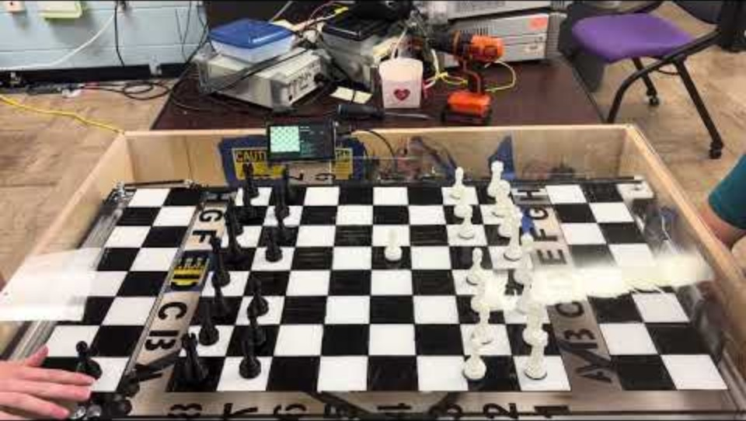
Demonstration

Slide 31
Outline
Problem Formulation
Standards, Ethics, and Broader Impacts
Overview of Conceptual Design
Detailed Design
Implementation and Experimentation
Demonstration
Lessons Learned

Slide 32
Lessons learned / Future work
Lessons Learned:
Order and test parts as soon as possible; our first screen was faulty when it arrived and took needed GPIO voltage pins, early testing allowed for us to reorder before it became a bottleneck
Flatness of the playing surface is a significant mechanical requirement.; the acrylic bow, the mid-span wooden support, and the uneven CoreXY frame supports each seemed like minor build issues (during assembly), but together they made two of our planned tests impossible to run
Throughout the Design process, take into account the AWG size of the wires in order to maintain Thermal and Current load concerns.
Having smaller scale prototypes/putting all cad drawings together to physically see design faults earlier is helpful.
Being generous with tolerances is important; it’s always better to not remove enough material than too much
Future Work:
Improve playing‑surface flatness with a stiffer board or added supports to ensure consistent electromagnet pickup
Replace electromagnet with a stronger, higher voltage alternative to allow it to stay lower and not be held by magnets in piece bases
Increase motion speed by raising available motor voltage, optimizing microstepping settings, and reducing frictional losses in the CoreXY path
Add difficulty levels for the AI, and the possibility to redo moves
Notes:
I learned that being generous with tolerances is important. It's always better to air on the side of caution in mechanical design.
Some future work that can be done on this project is making the top of the board flatter whether by changing the material or finding some way to better support the top. Also figuring out the proper magnet configuration; whether that be finding a mount height that works on a flat surface, or by replacing the current electromagnet with a stronger one. A stronger electromagnet would allow us to go with our original plan to use washers in the base of the pieces instead of magnets. An added benefit of that solution is that it would eliminate the problem of a piece gripping the electromagnet when it shouldn’t. Other things that can be done are increasing the speed of movement, adding AI difficulty levels and adding the ability to redo moves.

Slide 33
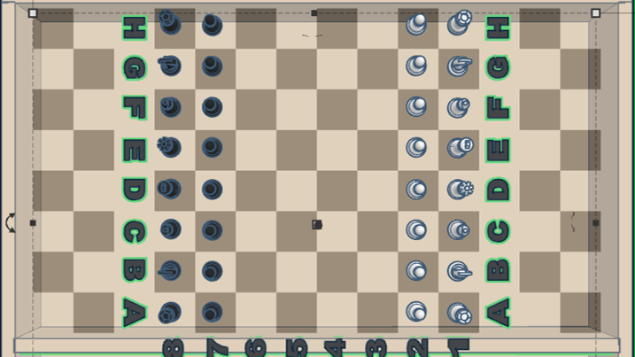
Statement of Contributions
Nathan: Background and Problem Formulation, Implementation (Peripheral Unit Slide), Overview of Budget, General Slide Design Review
Lewis: Standards, Ethics, and Broader Impacts (also reviewed Power Supply Unit slide)
Jack: Conceptual Design (also reviewed Processing Unit slide), Software, Lessons Learned/Future Work
Allison: Detailed Design (CoreXY Unit and Peripheral Unit slides), Updated Detailed Design (Summarized all added Specs/Constraints), Implementation (CoreXY Unit Slide), Lessons Learned/Future Work
Noah: Detailed Design (Processing Unit, Control Unit, and Power Supply Unit slides), Experimentation

